Slide 1
Joe
Local AI Orchestrator
Plan once · Execute locally · Verify always
spark-c5c0 · 192.168.1.125:628 · Edition 2026.05

Slide 2
Executive summary
Local-first orchestration in production
6
17+
42
Fleet nodes
Models on-prem
Skills loaded
25
100%
<10s
OpenClaw agents
Local inference
Avg deck build
Verified · Honest · No cloud-token cost on inference

Slide 3
The problem we solve
Why enterprises need a local orchestrator
• Cloud LLM tokens scale linearly with traffic — operating cost grows unchecked
• Multi-AI tools live in silos — no shared plan, memory, or accountability
• Hallucinated 'success' wastes engineering hours on returns and rework
• Iron-law compliance needs a runtime enforcer, not a wiki page
• Sensitive code and customer data should never leave the LAN

Slide 4
What Joe does
An orchestrator built on five pillars
• Local-first inference — Ollama across RTX 5090 / Arc A770 / NVIDIA fleet
• CEO-as-dispatcher — OpenClaw CEO routes work to the right sub-agent
• Honest pipeline — Plan → Probe → Install → Run → VERIFY artifact ≥ 1 KB
• Self-evolving — re-reads /skills/joe/lessons/ before every run
• Auto-installing — missing OpenClaw agents detected and provisioned on demand

Slide 5
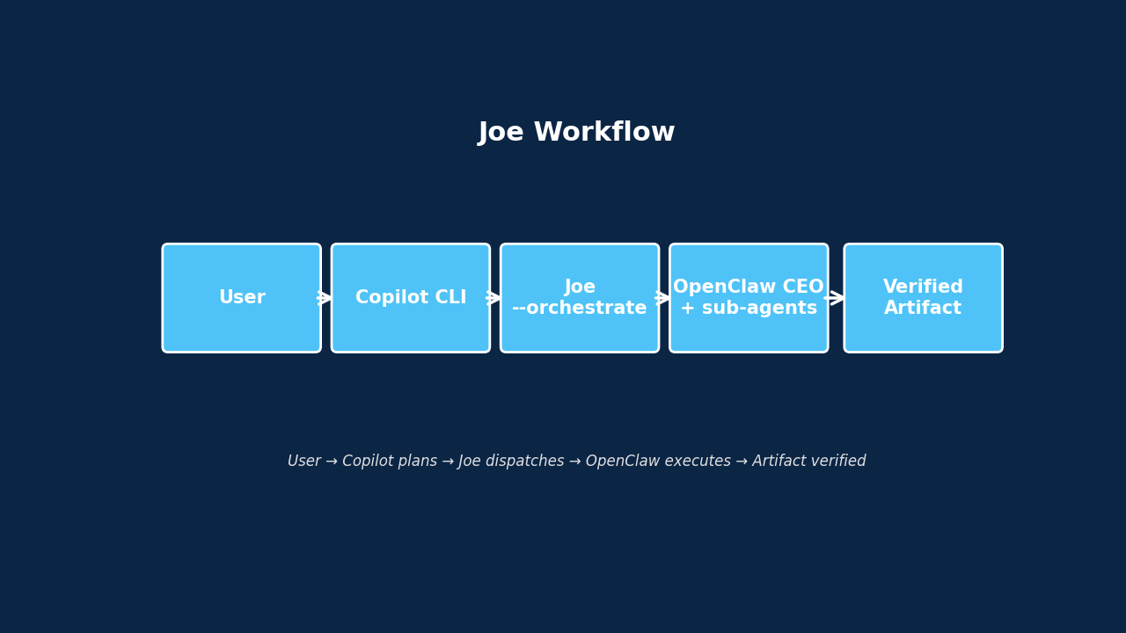
How it works
From request to verified deliverable
One command in. Verified artifact out. No silent failures.

Slide 6
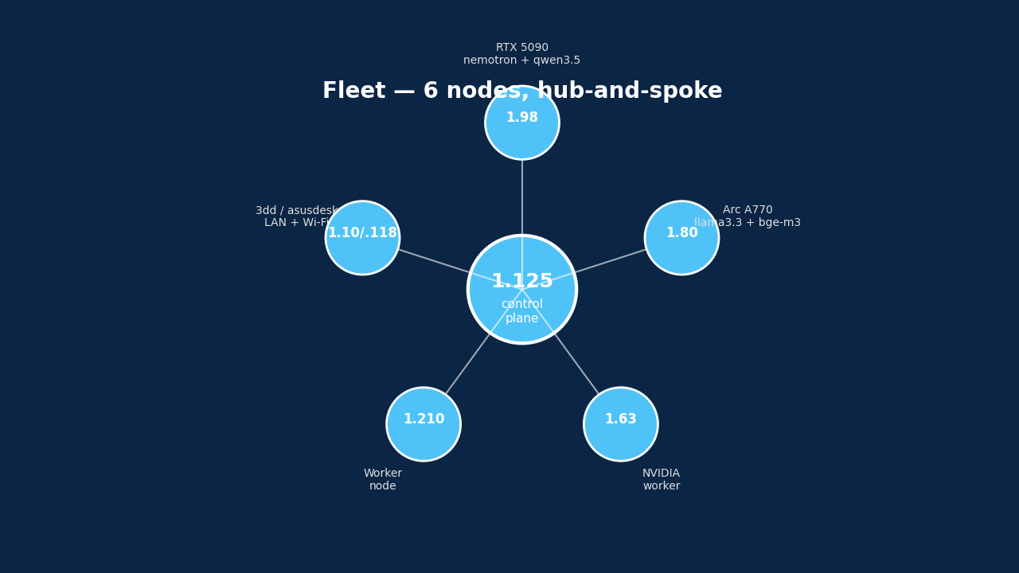
Fleet topology
6 nodes, hub-and-spoke, GPU-accelerated
• 1.125 — control plane · Copilot CLI · Joe
• 1.98 — RTX 5090 · nemotron · qwen3.5 · deepseek-r1
• 1.80 — Arc A770 · llama3.3 · bge-m3 · phi3
• 1.63 — NVIDIA worker
• 1.210 — worker node
• 1.10 / 1.118 — 3dd · asusdesk (LAN + Wi-Fi)

Slide 7
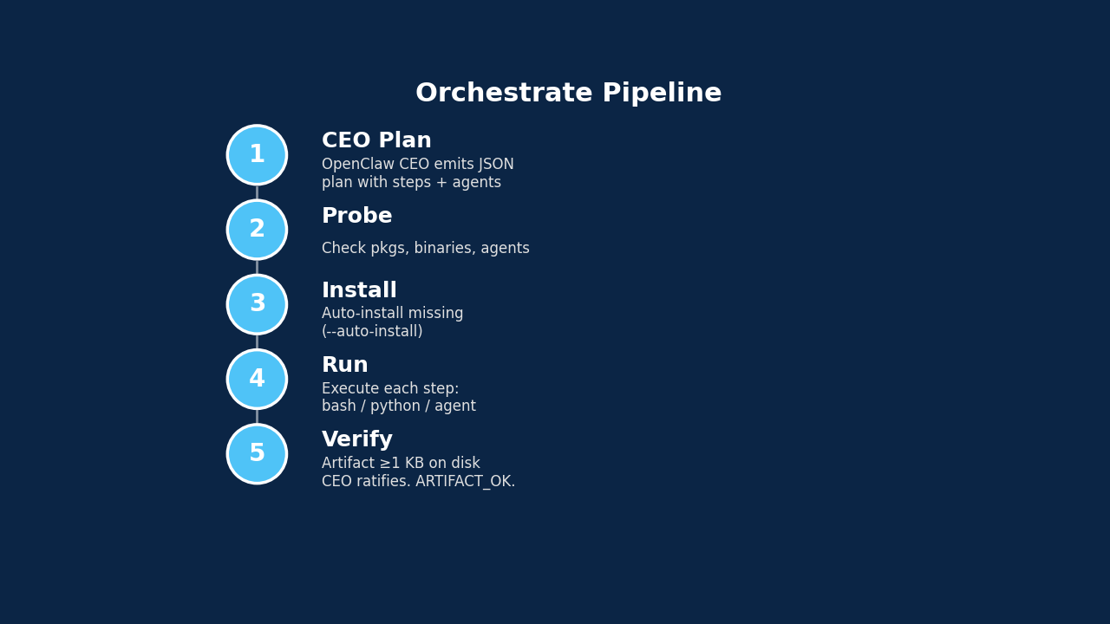
Orchestrate pipeline
Five gates between request and report
• Plan — CEO emits JSON plan
• Probe — pkgs · bins · agents
• Install — auto-yes optional
• Run — bash / python / agent
• Verify — file ≥ 1 KB on disk
• Report — CEO ratifies output

Slide 8
Models inventory
17+ open-weight models, deployed on-prem
Model | Size | Role | Primary node
nemotron-3-super | 86 GB | Premium reasoning | 1.125
llama3.3:latest | 42 GB | Long-context chat | 1.125 · 1.80
nemotron-3-nano | 24 GB | Fast reasoning | 1.125
joe:v1.3 | 19 GB | Joe planner | 1.125
deepseek-r1:32b | 19 GB | Code reasoning | 1.125 · 1.98
qwen2.5-coder:32b | 19 GB | Code generation | 1.125
gpt-oss:20b | 13 GB | CEO planner | 1.125 · 1.98
qwen2.5-coder:14b | 9.0 GB | Code generation | 1.125 · 1.98
llama3.2-vision | 7.8 GB | Vision · multimodal | 1.125
gemma2:9b | 5.4 GB | Lightweight chat | 1.80
llama3.1:8b | 4.9 GB | General chat | 1.98 · 1.80
qwen2.5:7b | 4.7 GB | General chat | 1.98 · 1.80
gemma3:4b | 3.3 GB | Edge inference | 1.125
phi3:3.8b | 2.2 GB | Edge inference | 1.80
nomic-embed-text | 274 MB | Text embeddings | all nodes

Slide 9
Skills catalog
42 reusable disciplines, auto-loaded before every run
Superpowers (24)
AirCore (17)
Joe + DevOps
• brainstorming
• test-driven-development
• systematic-debugging
• verification-before-completion
• subagent-driven-development
• dispatching-parallel-agents
• session-recovery
• writing-plans · writing-skills
• executing-plans
• code-review (req · recv)
• self-improving-agent
• openclaw-daily-mission
• loop-self-healing
• using-superpowers
• iron-law-6 · real-browser-verify
• iron-law-10 · parallel-by-default
• iron-law-12 · ten-minute-cap
• iron-law-21 · aider-dual-track
• iron-law-29 · cpu-headroom
• iron-law-32 · real-debug-100
• iron-law-37 · frontend-debug
• ccie-enterprise-fabric
• ccie-networking-ops
• ccie-sp-and-peering
• ccie-wireless-roaming
• device-adapter-pattern
• i18n-parity-discipline
• xadmin-endpoint-cloaking
• joe / SKILL.md (SOP)
• joe / lessons (auto-evolve)
• joe / templates (builtin)
• design-consultation · review
• qa · qa-only
• cso (security audit)
• ship · land-and-deploy
• benchmark · benchmark-models
• canary (post-deploy)
• office-hours · retro
• investigate · scrape
• iron_rules (#1-#40)

Slide 10
OpenClaw agent roster
25 specialised agents, grouped by function
Group | Agents
C-Suite | ceo_agent · cfo_agent · coo_agent · cto_agent · cro_agent
Engineering | engineer_agent · cto_agent · rd-db-integrity · rnd_manager
QA | aircore-qa · ceo-aircore-summary
PM / Ops | project_manager · task_coordinator · document_agent · meeting_agent
Domain — Isaac/USD | isaac-sim-expert · isaac_sim_engineer · isaac_sim_project_generator · isaac_lab_research · openusd_architect
Knowledge | knowledge_agent
Sales / CR | sales_manager_agent · client_relation_agent
Default / shim | main · acp-defaultagent

Slide 11
Business value
What local-first orchestration delivers
• Zero cloud-token spend on inference — fixed CAPEX replaces variable OPEX
• Data sovereignty — code · models · prompts never leave the LAN
• Verified artifacts — no silent failures, no rework loops
• Self-evolving — every task ends with a lesson; Joe gets smarter for free
• Composable — Copilot CLI plans, Joe dispatches, OpenClaw executes, CEO ratifies
• Fast time-to-value — a polished deck in under 10 seconds (this one)

Slide 12
Standards & governance
Iron Laws #1–#40 enforced at runtime
• #5 PostgreSQL only — no SQLite fallback
• #6 Absolute visual verification — real browser, multi-viewport
• #10 Parallel by default — multi-agent, multi-node
• #12 Ten-minute cap — no stuck tasks
• #32 Real-debug 100% — fix at the root, not the symptom
• #37 Frontend debug & evolve — chromium / mobile / iphone
• #40 Working disciplines — TDD · brainstorm gate · verify-before-done
• Source of truth: /skills/iron_rules/iron_rules.md (878 lines)

Slide 13
Usage
Copy-paste ready
# Dispatch any task — Copilot CLI calls Joe
joe --orchestrate --auto-install "<task>"
# Builtin deck task (this very deck)
joe --orchestrate "generate intro pptx + html"
# Refresh fleet topology
joe --refresh-topology
# Autorun AI-suggested shell code
joe --autorun "build me a CSV of fleet RAM"
# One-shot Copilot query
joe "<question>"
# Artifacts published at:
# http://192.168.1.125/files/

Slide 14
Roadmap & closing
Where Joe is heading next
• Q3 — More builtin templates (report, dashboard, runbook, RCA)
• Q3 — Agent autoscale across fleet based on VRAM headroom
• Q4 — CEO ratify quorum — multi-agent agreement before sign-off
• Q4 — Self-hosted RAG over /skills/ + project codebases
• Always — Local-first · Verified · Honest
Artifacts: http://192.168.1.125/files/

