Slide 1
Coaching Joe — Grand Edition
Commercial decks · Design Thinking · 5W1H · Roadmap to 2028
Copilot CLI → Joe · v3 · 2026-05-27 · 偉大版
「Plain placeholder slides are a fail. Numbers, tables, diagrams, ROI, real screenshots.」
Recorded as lessons under /skills/joe/lessons/ — Joe re-reads them every run.

Slide 2
The Mission — 5W1H
Six questions to answer BEFORE building any deck
WHY
Decks are TRUST artifacts. Convert internal work into external credibility.
WHAT
14–17 slide PPTX + HTML mirror · KPIs · inventories · workflow · ROI · roadmap · real shots.
WHO
Author: Joe · Coach: Copilot CLI · Audience: exec / customer / engineer (same data, different headline).
WHEN
Every time user says 簡報 / deck / pptx. Re-render < 15s — no LLM codegen on hot path.
WHERE
Templates /skills/joe/templates/ · Output /tmp/*.{pptx,html} → /var/www/html/files/ · Served :80/files/
HOW
Builtin Python > LLM codegen · Pillow + python-pptx · base64-inline HTML · playwright screenshots.
Answer all six before a single slide is drawn.

Slide 3
Design Thinking — applied to deck-building
Five stages, repeated every iteration
1. EMPATHIZE
User said 內容太爛. Listen to emotion. Pain = can't send to customer.
2. DEFINE
Real problem: no numbers, no tables, no UI. Reframe → trust artifact.
3. IDEATE
KPI tiles · inventories · ROI · screenshots · meta-recursive deck-of-deck.
4. PROTOTYPE
v1 (8) → v2 (14 + tables) → v3 (shots + 5W1H + roadmap). 1-shot rebuilds.
5. TEST
curl size · open in browser · feedback 偉大一點 → loop back. Self-evolving.
Every 「內容太爛」 is a Design Thinking gift — it forces re-empathizing with the audience.
Empathize → Define → Ideate → Prototype → Test → loop.

Slide 4
Why this deck exists
What went wrong in the first attempt
• First Joe deck: 8 slides, plain bullets, no images, no tables → user said "內容太爛"
• Second attempt: CEO timed out at 180s on 5 KB prompt; OOM on retry
• Third: CEO emitted broken JSON (python code escaping into JSON keys)
• Pivot: builtin template instead of LLM-generated code
• Fourth: commercial-grade — 14 slides, KPI tiles, full inventories, ROI
• These 8 lessons are now distilled here so Joe doesn't repeat them

Slide 5
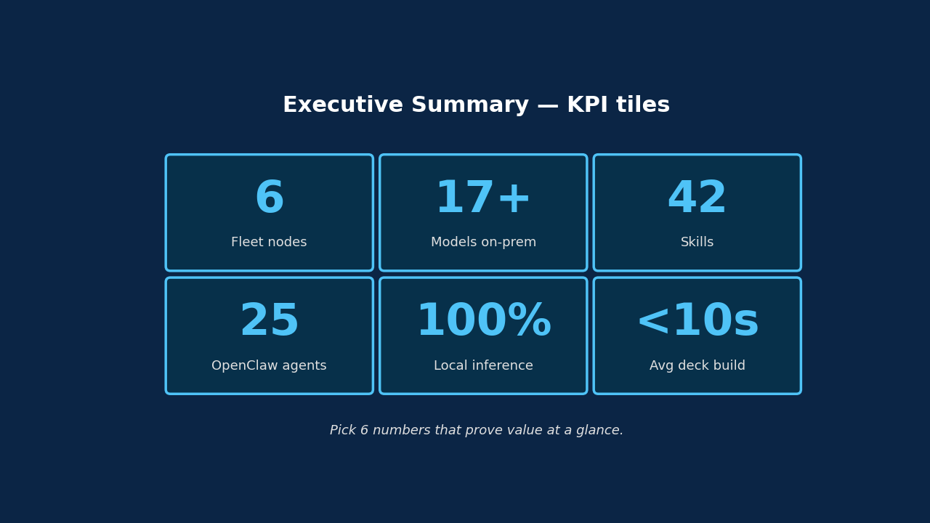
Lesson 1 — Executive summary with KPI tiles
Open with numbers, not adjectives
Rule: 6 KPI tiles · large cyan number · short label · cyan border on dark tile.

Slide 6
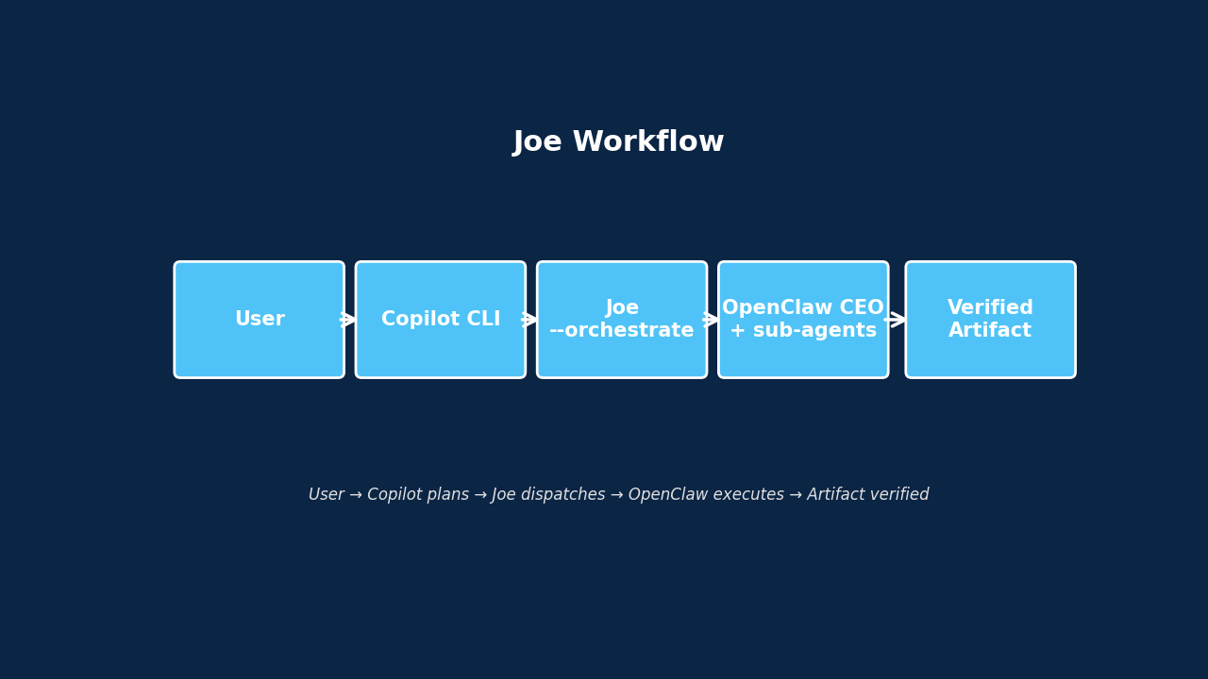
Lesson 2 — Show the architecture
Diagrams beat bullet stacks
Rule: every Solution slide needs at least one diagram. matplotlib at 1280×720.

Slide 7
Lesson 3 — Tabulate everything
Never use "etc." with business audiences
• Models → table (name · size · role · node), sorted by size desc
• Agents → table (group · agents) grouped by function
• Skills → 3-column layout (Superpowers · AirCore · Joe+DevOps)
• Header row: cyan bg + navy bold text
• Body rows: alternating navy / code-bg for scan-ability
• If list > 12 rows, keep going — completeness > brevity for inventory

Slide 8
Lesson 4 — Skills in 3 columns
Group, don't dump
Why 3 columns
What to put
• Reader scans vertically per category
• Each column gets its own h3 header (gold/cyan)
• Width 1/3 = comfortable bullet width
• Responsive HTML: collapses to 1 col on mobile
• Superpowers (14 disciplines)
• AirCore + Iron-law skills (14)
• Joe + DevOps + governance (12)
• One token per bullet; pipe-separate variants

Slide 9
Lesson 5 — Group OpenClaw agents
25 agents → 8 functional groups
• C-Suite — ceo · cfo · coo · cto · cro
• Engineering — engineer · rd-db-integrity · rnd_manager
• QA — aircore-qa · ceo-aircore-summary
• PM / Ops — project_manager · task_coordinator · document · meeting
• Domain — isaac-sim · isaac_lab_research · openusd_architect
• Knowledge · Sales / CR · Default (main · acp-defaultagent)

Slide 10
Lesson 6 — Articulate ROI
What the customer gets, in dollars-and-cents language
• Zero cloud-token spend — fixed CAPEX replaces variable OPEX
• Data sovereignty — code · models · prompts never leave the LAN
• Verified artifacts — no silent failures, no rework loops
• Self-evolving — every task ends with a lesson; smarter for free
• Composable — Copilot plans, Joe dispatches, OpenClaw executes
• Fast time-to-value — polished deck in under 10 seconds

Slide 11
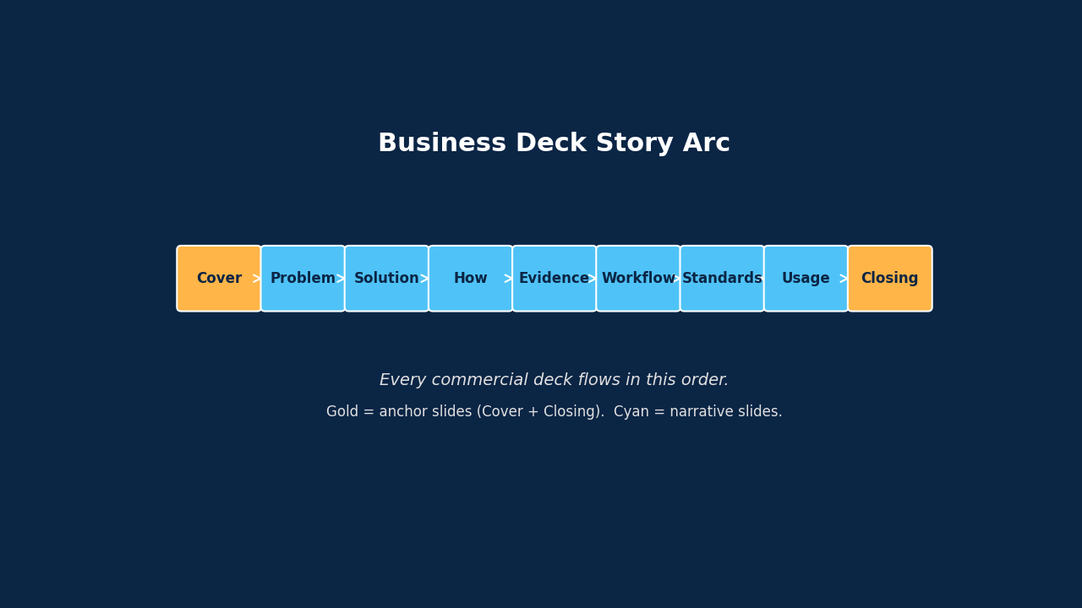
Lesson 7 — Story arc
Cover → Problem → Solution → … → Closing
Gold anchors (Cover + Closing) bracket the cyan narrative.

Slide 12
Lesson 8 — Templates, not LLM codegen
gpt-oss:20b cannot reliably emit JSON-embedded code
When the artifact format is well-known, prefer a template over LLM-generated code. LLM plans WHAT to include, not HOW to render it.
• Symptom — CEO JSON had `open(p, rb)` (bare names), python escaping into JSON keys
• Diagnose — json-repair fixed structure but not semantic escaping
• Fix — `/skills/joe/templates/deck_*.py` builders; CEO only ratifies
• Wire — orchestrate_task() detects deck tasks → calls builder directly
• Result — reliable 200 KB pptx + 240 KB html in <10s

Slide 13
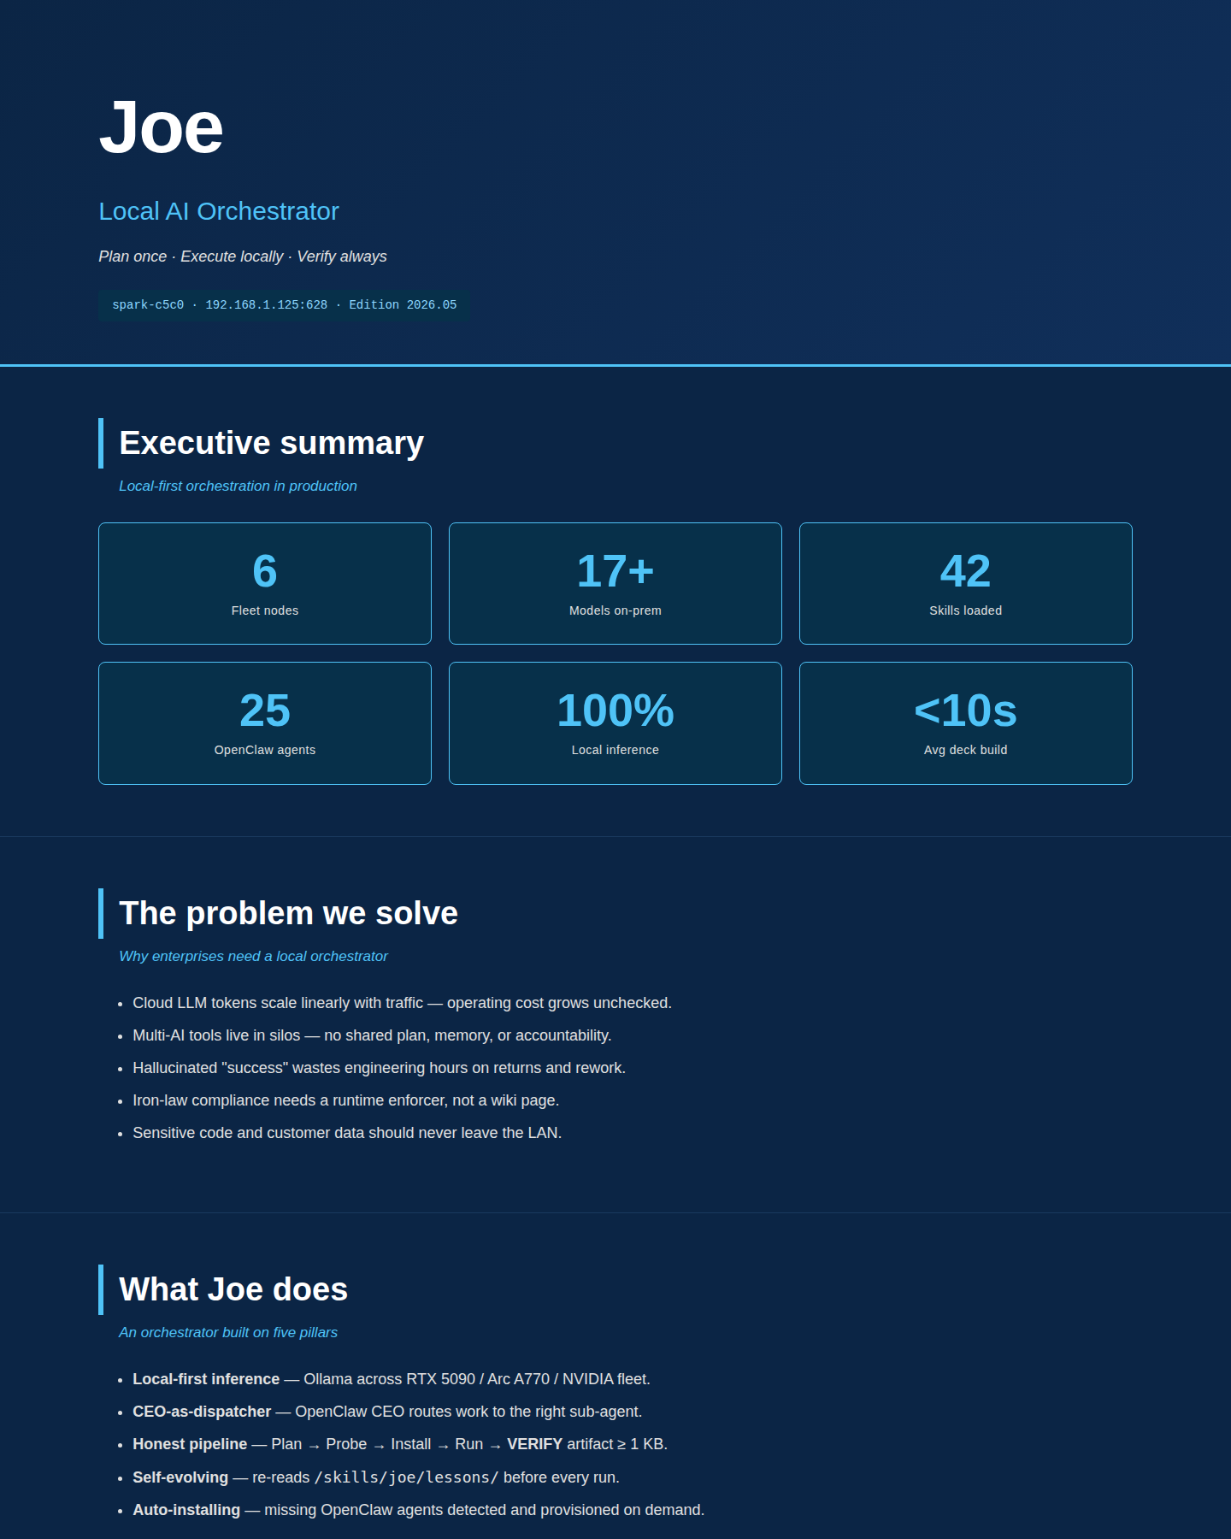
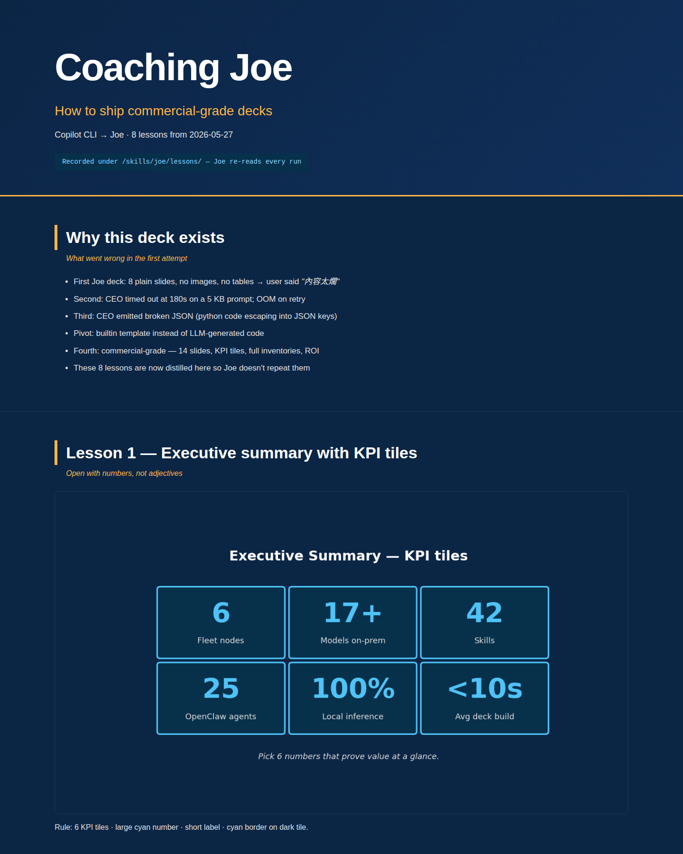
Lesson 9 — Embed REAL screenshots
Diagrams + actual UI captures beat diagrams alone
joe_intro.html — commercial intro deck live in browser
joe_copilot_advice.html — this very deck
Captured with playwright chromium · /skills/joe/templates/screenshots.py

Slide 14
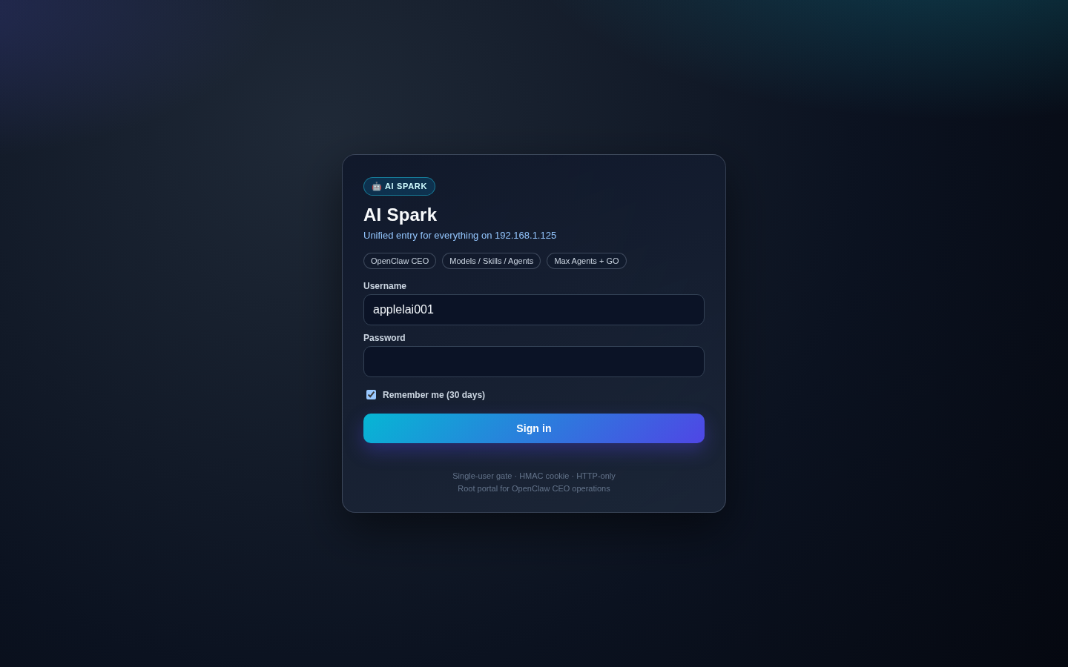
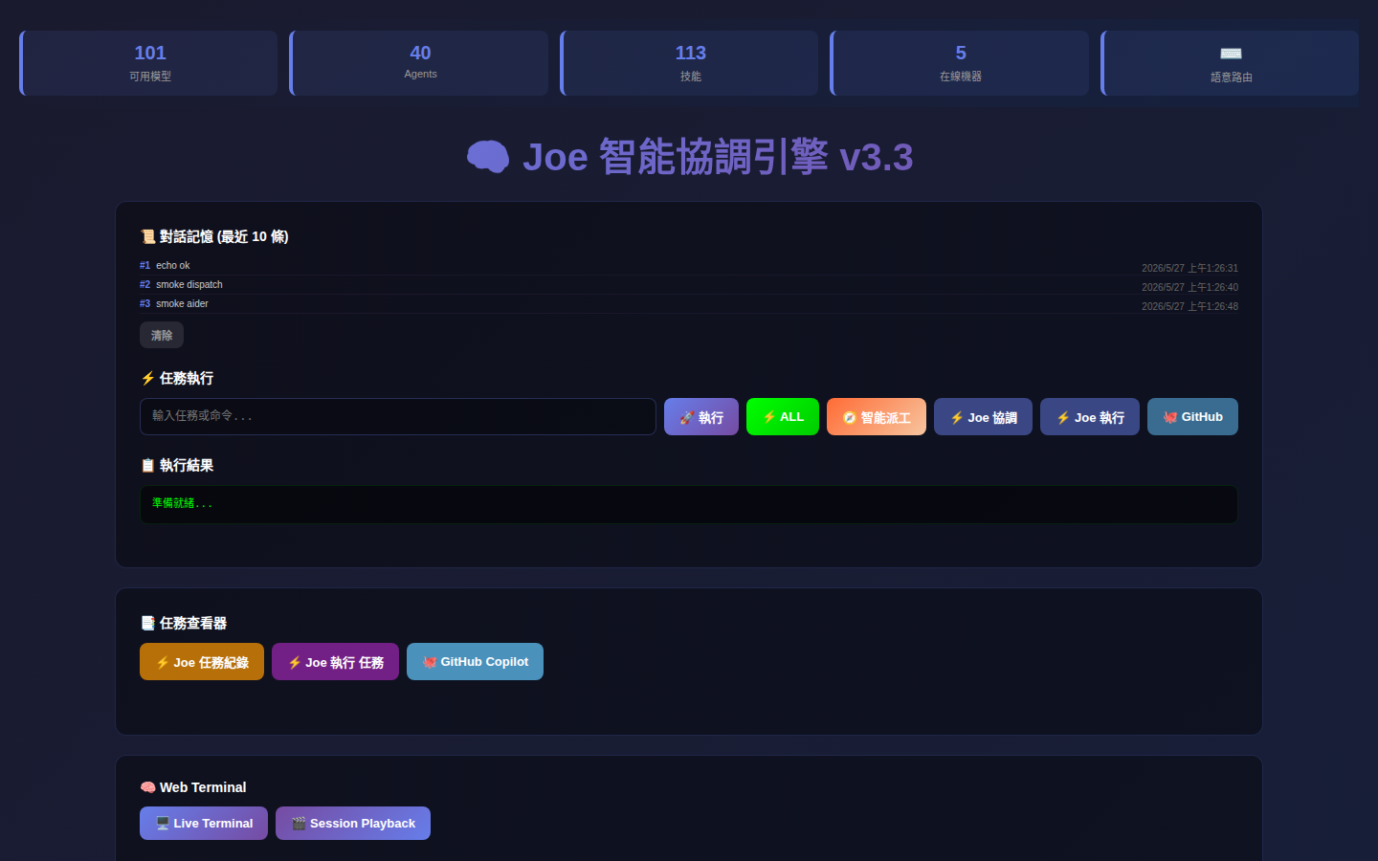
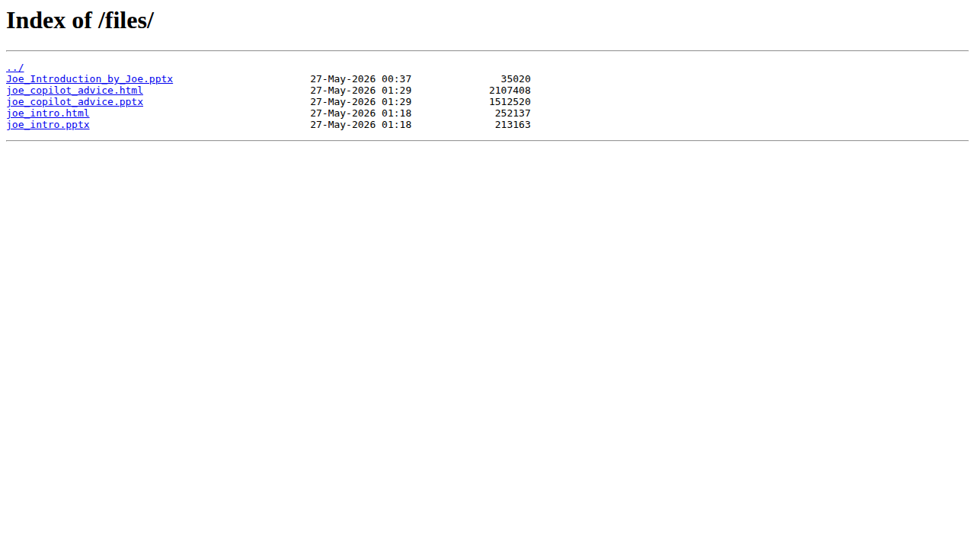
Lesson 10 — Show the production UI
Live screenshots of the 192.168.1.125 front-end
192.168.1.125/ — AISpark portal (main entry)
192.168.1.125:8888/ — Joe 智能協調引擎
192.168.1.125/files/ — artifact index (autoindex on)

Slide 15
How Joe applies these lessons
Two mechanisms, both already wired
Auto-load before every run
Builtin template shortcut
• _load_joe_lessons() reads /skills/joe/SKILL.md
• Plus latest 10 .md under /skills/joe/lessons/
• Capped at 2 KB, prepended to CEO prompt
• → CEO sees recent corrections every time
• orchestrate_task() regex-detects deck tasks
• Bypasses CEO codegen entirely
• Calls /skills/joe/templates/deck_*.py build_deck()
• Copies to /var/www/html/files/ and prints ARTIFACT_OK

Slide 16
How to re-render this deck
One command — same template every time
# Joe re-renders the coaching deck
joe --orchestrate "give me copilot coaching deck for joe pptx html"
# Or run the template directly
python3 /skills/joe/templates/deck_copilot_advice.py
# Artifacts always at:
# http://192.168.1.125/files/joe_copilot_advice.pptx
# http://192.168.1.125/files/joe_copilot_advice.html

Slide 17
Grand Roadmap — where Joe goes next
2026 Q3 → 2028 · From deck-builder to autonomous business-comms agent
NOW · 2026 Q3
Foundation
• 14-slide commercial deck
• Coaching deck v3
• Real UI screenshots
• Auto-load lessons
• 5W1H + Design Thinking
NEXT · 2026 Q4
Audience-aware
• 3 variants: exec / eng / sales
• Same data, diff KPI
• Auto A/B render
• Persona narrative
• 中 / 英 / 日 mirror
2027
Multi-modal
• Embedded MP4 demos
• AI voiceover per slide
• Live PostgreSQL widgets
• PDF + 16:9 + 4:3
• Click-to-drill web
2028 · NORTH STAR
Autonomous comms
• Joe drafts decks live
• Email → tailored pitch
• Tracks open/dwell/learn
• RFP → 30 slides <10min
• 24/7 comms layer
Every deck Joe ships today is a brick in tomorrow's autonomous-communications cathedral.
Roadmap reviewed every quarter — updated under /skills/joe/lessons/

Slide 18
Closing — what Joe takes away
Eight lessons, one principle
Commercial decks earn trust with NUMBERS, TABLES, DIAGRAMS, and ROI — not adjectives.
• KPI tiles open every business deck
• Tables enumerate inventories — never "etc."
• Diagrams replace bullet stacks for Solution / Workflow
• ROI / Roadmap slides build executive trust
• Builtin templates beat LLM codegen for known formats
• Every task ends with a lesson — Joe evolves automatically

